Slide 1
Teams and Teamwork
Version 2.0
© Maurizio Morisio, Luca Ardito 2024

Slide 2
Team formation
By students
Unfair to students who do not have a local network (ex.: Erasmus)
By teacher
Same approach for all students
Similar to what happens in work environment

Slide 3
Catme.org
Developed by Purdue University
Used by 2200 instructors, 11M students
Team formation
Team evaluation

Slide 4
Team formation
Algorithm tries to form teams balanced on a number of factors
Age, sex, previous grades
Commitment
Personal styles
1 Questionnaire to collect factors
2 algorithm forms teams
Layton, R. A., Loughry, M. L., Ohland, M. W., & Ricco, G. D. (2010). Design and validation of a web-based system for assigning members to teams using instructor-specified criteria. Advances in Engineering Education, 2, 1-28.

Slide 5
Team evaluation
At end of project
Peer evaluation
Each team member evaluates the other members on a number of factors
Will be used for individual grade on project
Project grade (technical factors only)
Individual grade = f (peer evaluation, project grade)

Slide 6
Typical problems
(happen rarely, but happen..)
Team member leaves
Grade increased for teams <4 people
Team member does not work / works less
Analysed case by case. Email me soon
Arguments between team members
Try to avoid (see later)
Email me

Slide 7
Single person

Slide 8
Personality
Persons are different..
Personality: stable set of characteristics that define a person and her interaction with the environment
Defined by genetics
Defined by environment
Defined by both

Slide 9
Personality models
Big five
Myers Briggs
..many more

Slide 10
Big five
Neuroticism
Self esteem, more to less
Openness
Curious/original or not
Conscientiousness
Organization, perseverance
Extraversion
Social or not
Agreableness
Kindness, gentleness

Slide 11
Myers Briggs
Extraversion – introversion
Sensing – intuition
Thinking – feeling
Judging – perceiving
16 possible combinations

Slide 12
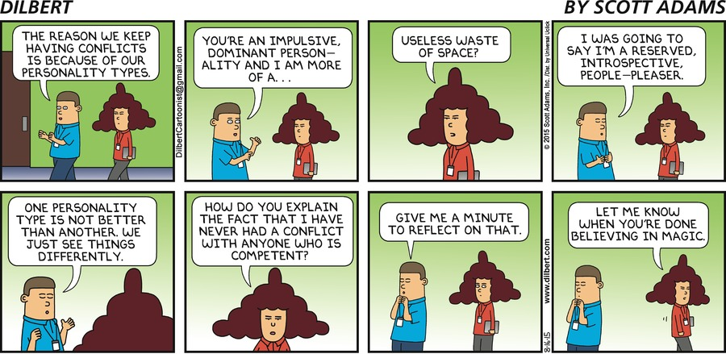

Slide 13
Personality and work
What is best mix of personalities in a team?
What is best personality for a job function?
Ex sales person, extraversion

Slide 14
Catme uses
Leadership role (leading – following)
Detail – big picture
(commitment level)

Slide 15
Teams

Slide 16
Factors affecting teams
Size
Norms
Specialization
Status
Leadership
Mood

Slide 17
Size and group dynamics
2 people: in case of confict no third person to arbitrate discussion
Either conflicts are hidden or avoided
Or conflicts get to explode
(avoid 2 people teams)
3 people: in case of conflict possible coalition 2 to 1
Stress, frustration of the isolated person
(avoid 3 people teams)

Slide 18
Size
4 people. ( ABCD)
7 possible configurations (group dynamics)
A – BCD B – ACD C-ABD D – ABC AB-CD AC-BD AD – BC

Slide 19
Size
8-10 people
Communication problems (not all speak out)
Subgroups can form
Individualities prevail
Need of more formalization
Less participation

Slide 20
Size
Recommended size: 4 to 7

Slide 21
Size and our project
4 people
Risk: 1, 2 team members leave

Slide 22
Norms
Work hours and punctuality
Etiquette and social norms
How to greet
How to clean
How to interact (who starts interaction and how)
Control (on rules, on work)

Slide 23
Norms
Productivity
What is too much / too little work
Protest
How and when to express discomfort / conflict

Slide 24
Norms and our project
Define clearly your norms, upfront!
Speak up and do not allow hidden stress to explode too late
Be flexible, too
Postel’s Law: Be conservative in what you do, be liberal in what you accept from others.

Slide 25
Status
Relative position of person vs others in team (vs others in society)
More status → more respect from others, more influence
Should depend on actual skills, contribution to group

Slide 26
Status
Formal status (ex leader) vs actual status recognized by others
If formal status is not consistent with actual status then conflicts arise

Slide 27
Recognize actual status, make formal status follow actual status

Slide 28
Specialization
Team members do all tasks vs team member specialized in a task
Ex testing, configuration management, requirements
No specialization: members are interchangeable, no delays if one member cannot work
Specialization: more productivity

Slide 29
Specialization can be a plus sometimes. For this project I hope you do not apply it, otherwise you do not learn all parts of the course

Slide 30
Leadership
Some activities may (or may not) be delegated to one recognized person in the team
Strategic decisions
Coordination decisions (who does what)
Information collection and sharing
Spokesman to outside team (presents results, asks resources)
Conflict resolution, motivation, trust

Slide 31
Leadership
One person (team leader) can be in charge of all of them
Or different people can be in charge, in function of their skills and experience
Situational leader: leader is not defined from outside, but emerges in the team

Slide 32
Leadership
Hierarchical style
Activities completely in charge of leader (may generate conflicts and dissatisfaction)
Democratic style
Decisions discussed by team and taken together (may result in excessive compromise or long delays)

Slide 33
Find a reasonable compromise between the two styles
The leader has high formal status, his/her actual status should correspond to the formal status

Slide 34
Mood
Perceptions of team members, about team, about context, about leader
Negative
Positive
Leadership is recognized, roles are recognized, goals are shared, communication is effective, feedback is requested and useful

Slide 35
The fearless organization
Psychological safety [Edmonson 2019]
Organizations where members can express critiques, ideas, proposals, succeed
Google (2017)
Organizations where members cannot, on the long run, fail
VW, Dieselgate

Slide 36
Groupthink
(opposite of fearless organization)
All team members think (decide, work) in the same way
No diversity
No discussions
Risk of not recognizing bad decisions
Depends on ‘bandwagon’ cognitive bias
As humans we are less anxious if our thoughts and behaviour follow the trend of the majority

Slide 37
Lifecycle of team
Initial: ‘chaos’, analysis, socialization to define roles and relationships
Storming: more confidence, possible conflicts arise
Cohesion: issues are recognized, discussed and solved without personal conflicts
Performing: team is conscious of being an entity, with proven skills and capacities

Slide 38
Aim to ‘cohesion’
Always express issues, avoid to transform them in personal issues

Slide 39
Indicators of trouble
Dependence from leader: leader must solve all problems, without leader’s input no work is done
Defense mode: the group has to fight an (invisible) enemy, most effort is on (talk about) fighting the enemy
Fatalism: the solution will come, someday, somehow
Groupthink: all group members always have same opinions

Slide 40
Summary
Working in teams is a necessity
Issues and conflicts are the norm, not the exception
Define rules and norms and expectations upfront
Recognize conflicts, discuss them openly
Awareness and soft skills can make working in teams pleasureful and productive

Slide 41
Project personnel
Key activities requiring personnel:
requirements analysis
system design
software design
implementation
testing
training
maintenance
quality assurance

Slide 42
Choosing personnel
ability to perform work
interest in work
experience with
similar applications
similar tools or languages
similar techniques
similar development environments
training
ability to communicate with others
ability to share responsibility
management skills

Slide 43
Work styles
Extroverts: tell their thoughts
Introverts: ask for suggestions
Intuitives: base decisions on feelings
Rationals: base decisions on facts, options

Slide 44
Organizational structure
Depends on
backgrounds and work styles of team members
number of people on team
n people, max interactions = n²/2
management styles of customers and developers
Examples:
Chief programmer team
Egoless approach

Slide 45
Organizational structures
Highly structured
high certainty
repetition
large project
Loosely structured
uncertainty
new technology
small projects

